Slide 1
CAPSTONE PROJECT
Submitted By:
Abhaya Prakash Shahare
Ajeet Singh Shekhawat
Course and Batch: DSP-01 Oct 2019

Slide 2
OBJECTIVE
The main objective is to predict the probability of default, whether the customer will default the loan or not by using the past data.
That means, given a set of new predictor variables, we need to predict the target variable as 1 -> Defaulter or 0 -> Non-Defaulter.
Dataset Description: Contains 855969 rows and 73 columns

Slide 3
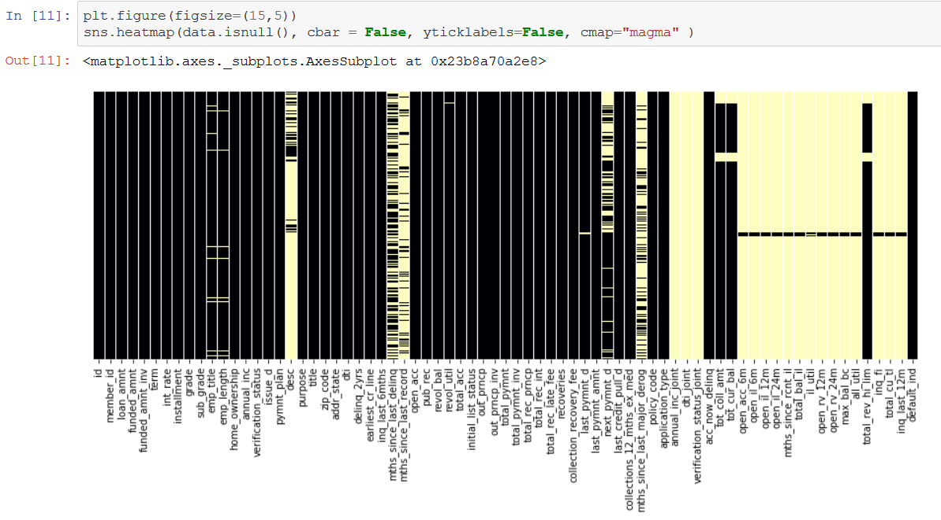
Data Exploration and Cleaning:
Dropping away the irrelevant columns–
Using heatmap we could visualize that our dataset contains a lot of missing values.

Slide 4
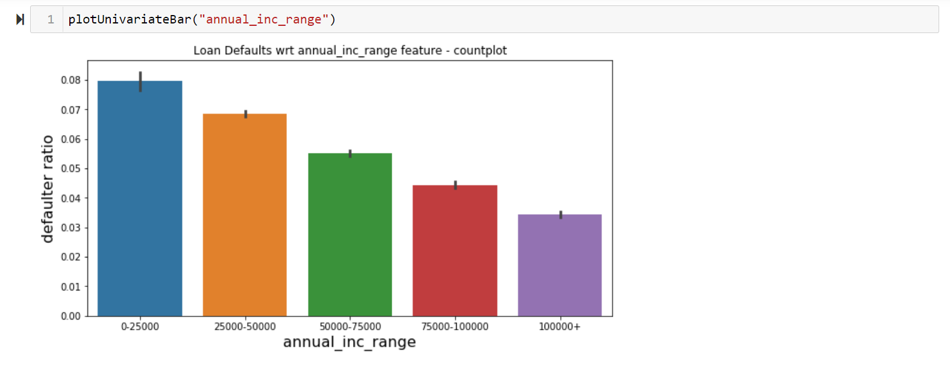
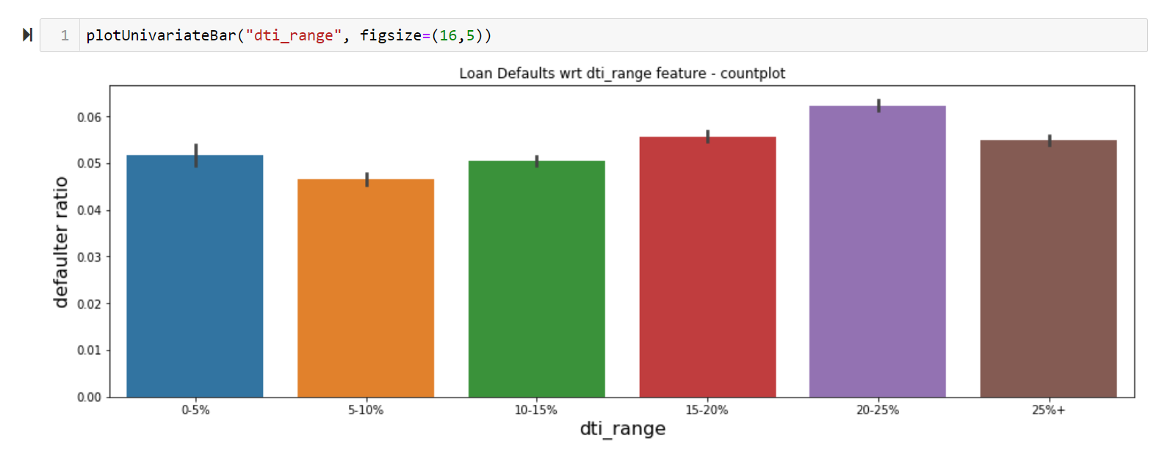
Data Exploration and Cleaning:
Dependency of the output variable on various features observed by plotting graphs.

Slide 5
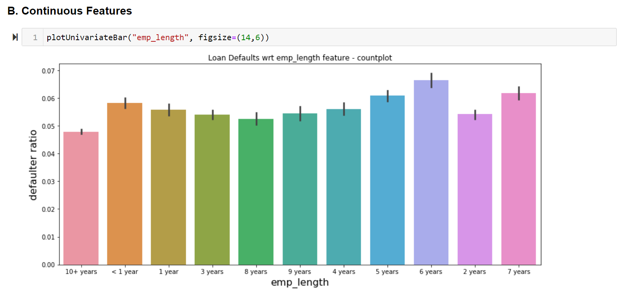
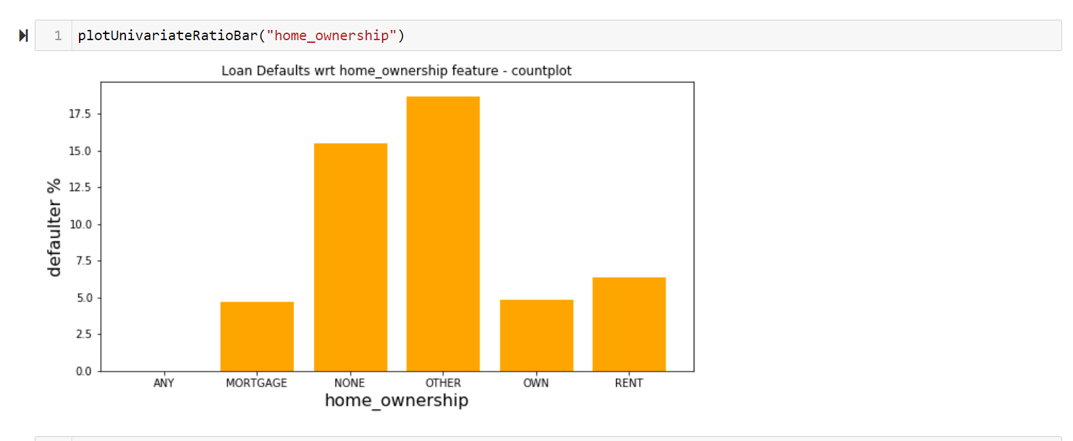
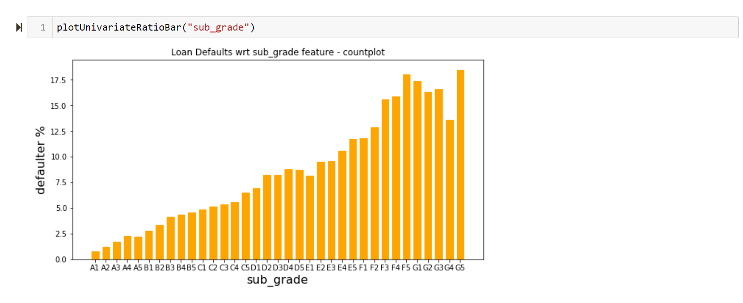
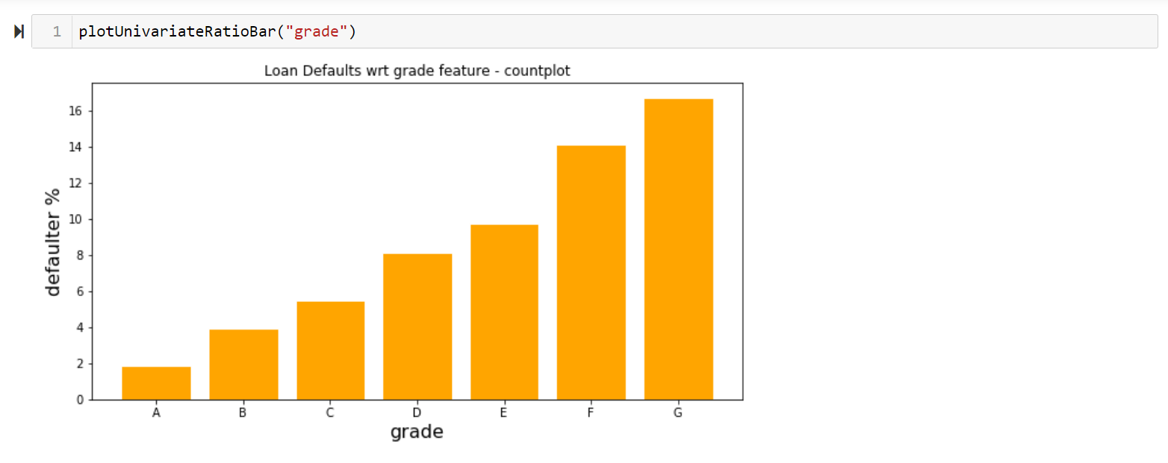

Slide 6
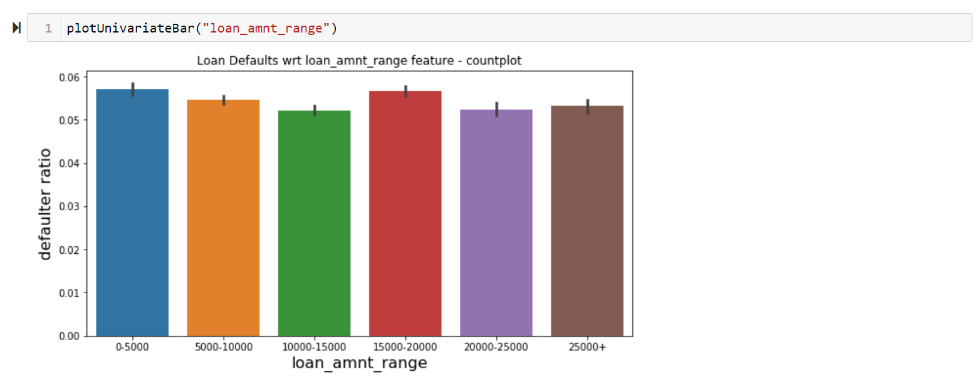
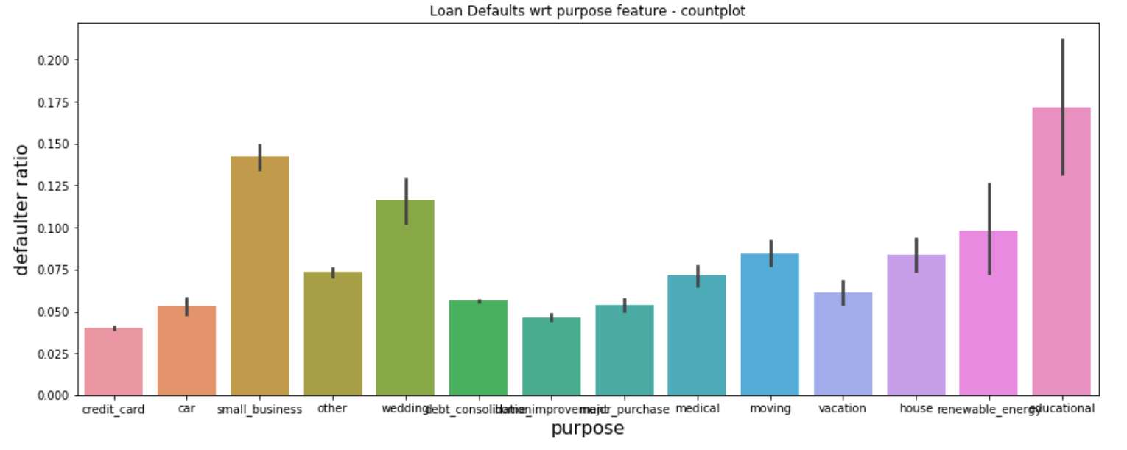
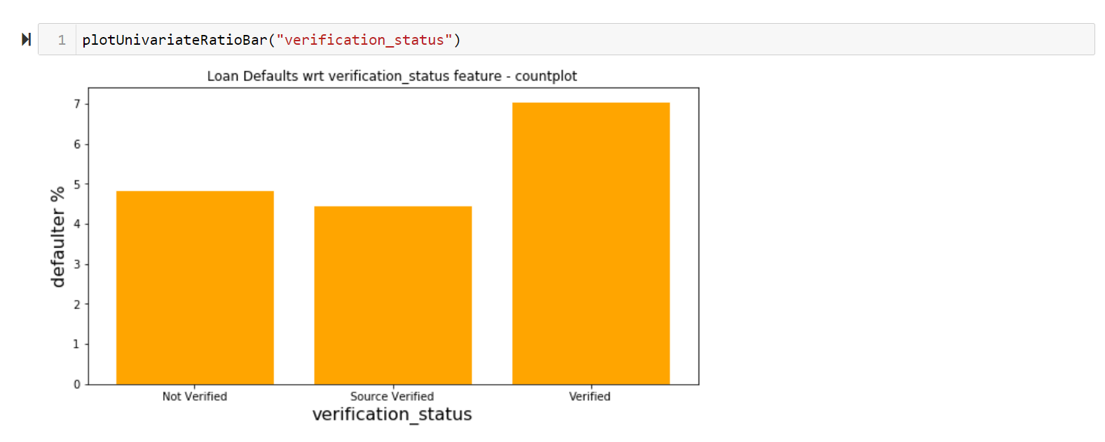
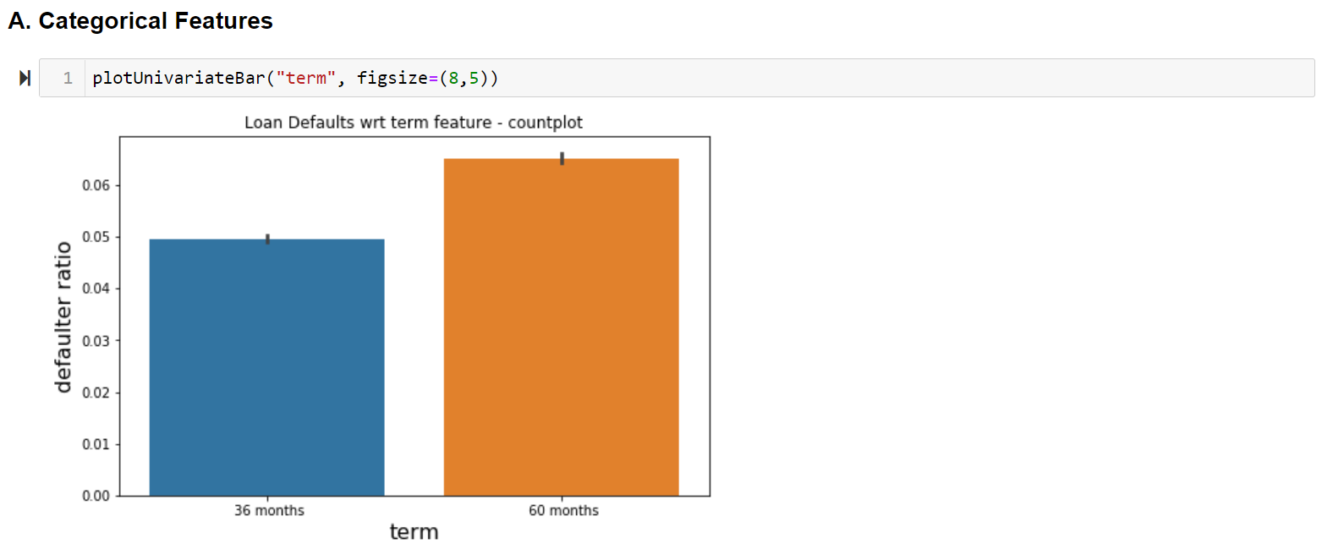

Slide 7
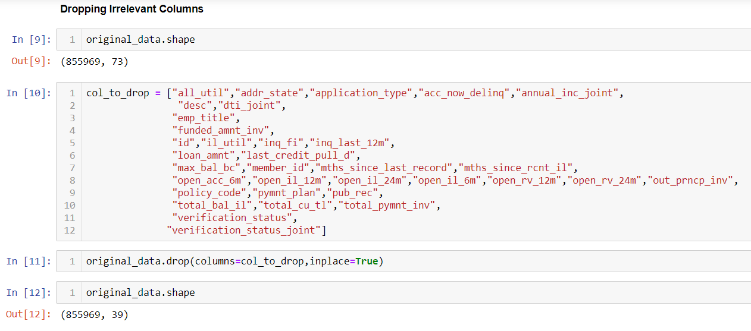
Data Extraction and Cleaning:
The dataset does not consists any duplicate records.
All the irrelevant variables are dropped with proper reasoning and studying the graphs. We’re now left with 39 variables.

Slide 8
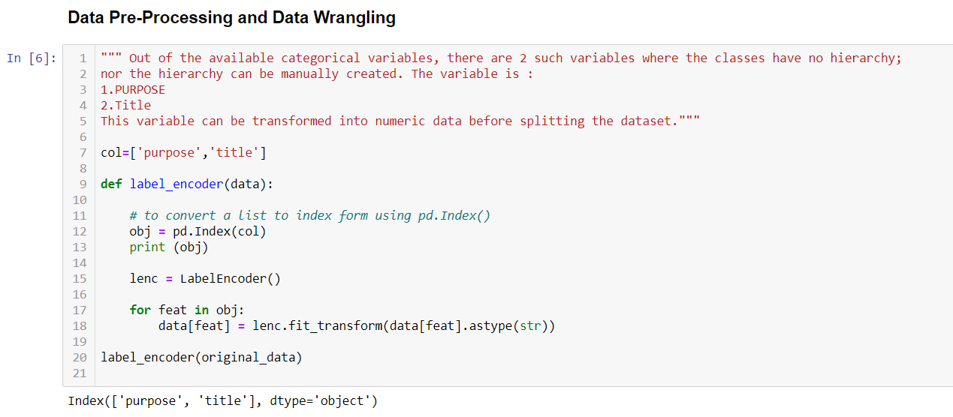
Data Pre-Processing and Data Wrangling:
Out of the available categorical variables, there are 2 such variables where the classes have no hierarchy, but the hierarchy can be manually created. The variables are :
1.PURPOSE 2.TITLE
This variable is transformed into numeric data using “Label Encoder” before splitting the dataset.

Slide 9
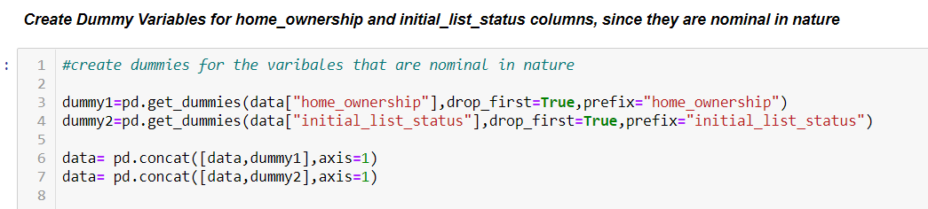
The categorical variables that are nominal in nature are converted to numerical values by creating Dummy Variables.
1. home_ownership 2.initial_list_status

Slide 10
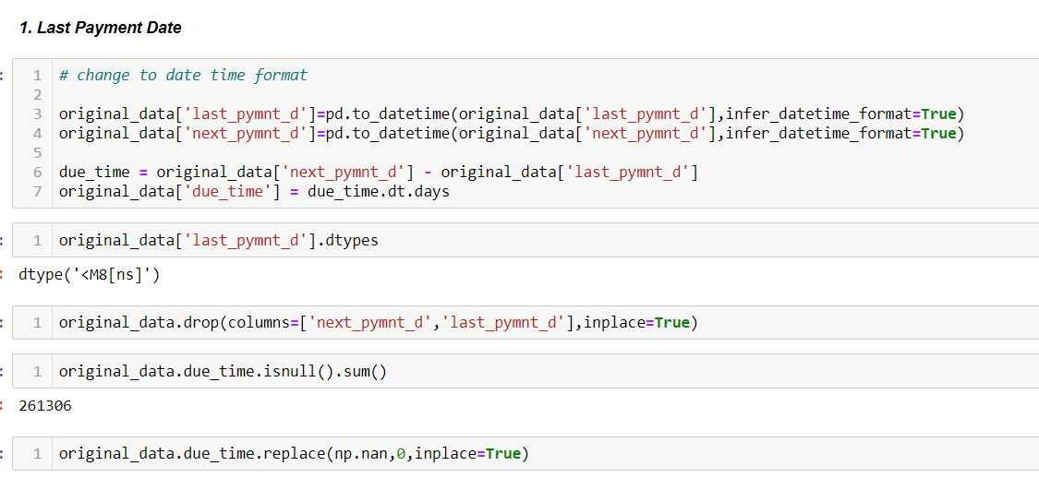
Null Value Treatment and Feature Manipulation:
The difference between next payment date and last payment date can provide us with the information of for how long the installment amount has been due.
A new variable named “due_time” is created using these two variables. “last_pymnt_d” and “next_pymnt_d” deleted in the latter.

Slide 11
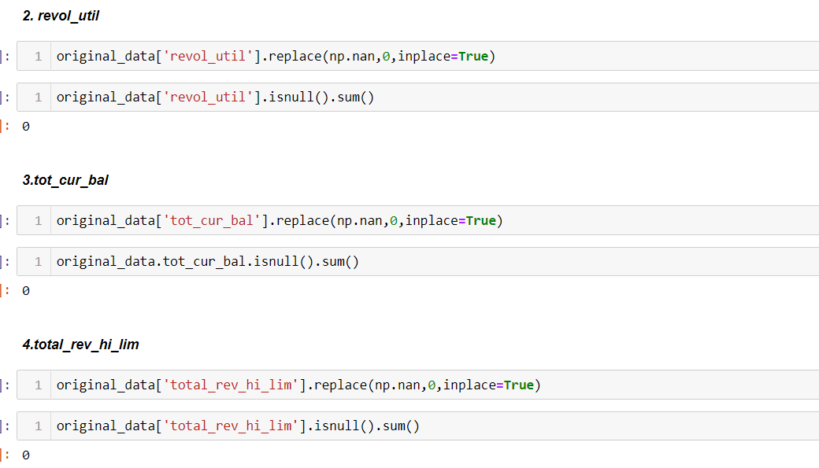
Before transforming the Object data types to numerical data types, the null values are to be treated .
The null values are replaced with value 0, under the assumption of data unavailability.

Slide 12
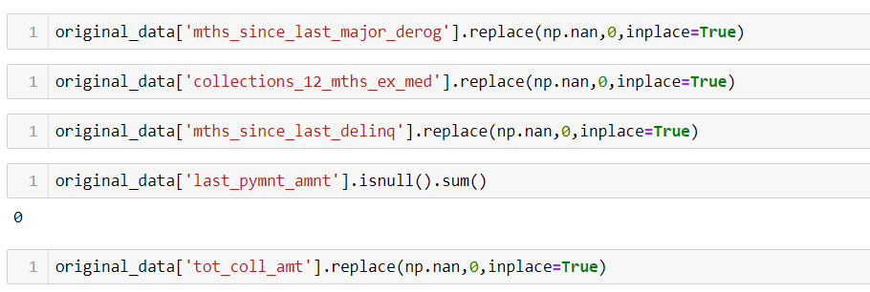
All the null values are now converted to non-null values and the data set is ready for the further process.

Slide 13
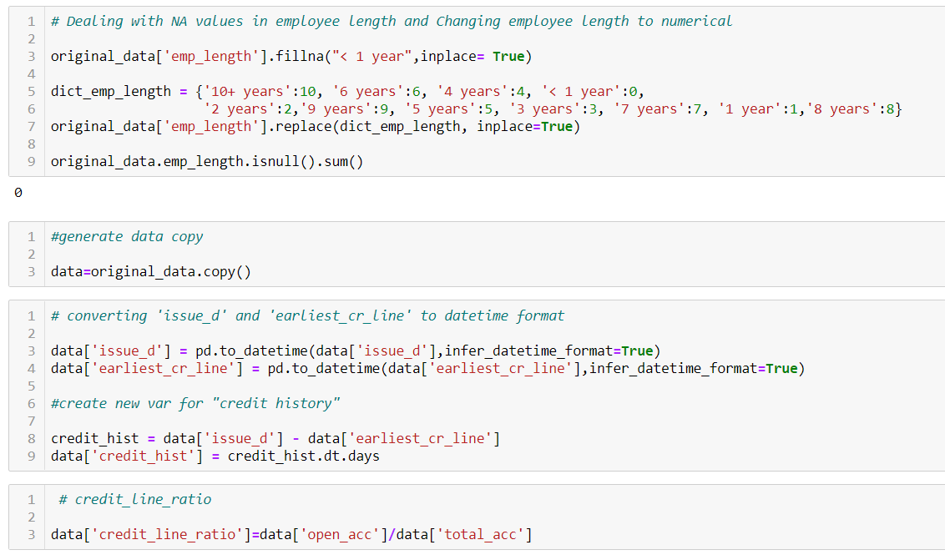
A new feature called “credit_hist” created to give information about the credit history of a loan applicant. The feature values are calculated using values from variables “earliest_cedit_line” and “issue_d”
A new feature created using “open_acc” and “total_acc” and entitled as “credit_line_ratio”, a feature that gives information about how many credit lines are available w.r.to the total credit lines for an applicant.

Slide 14
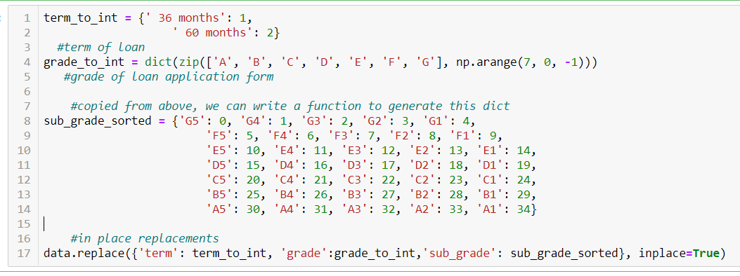
The remaining variables such as emp_length, grade, subgrade, and term, converted to numeric values using Manual Encoding as follows :

Slide 15
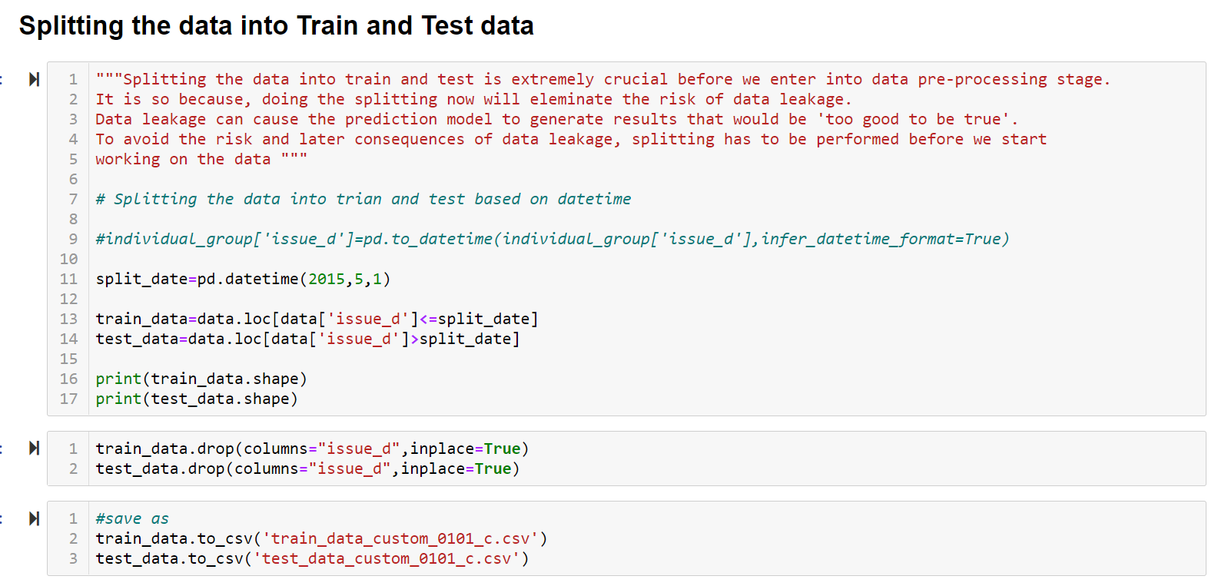
Train-Test Data Split:
As per the documentation, the available data has been split into train and test.
The data has been split into Train and Test based on the “issue_d” variable.
The data before from June 2007- May 2015 is the Train data and data from June 2015-Dec 2015 is the Test Data.

Slide 16
Model Selection:
The available train data is now used to perform the model selection and testing process.
The test data is kept untouched.
The train data is split into train and test data for model selection purpose.
The data is imbalanced in nature. Hence first the data is balanced using SMOTE function.
Before heading towards model selection, the features that are available at this point in time will be tested alongside the output variable to know which feature has greater impact on the output variable.
For feature selection purpose, SelecKBest() function is being used.
Based on the score, the features that have the greater score values are selected and the ones will relatively low scores are deleted from the data.

Slide 17
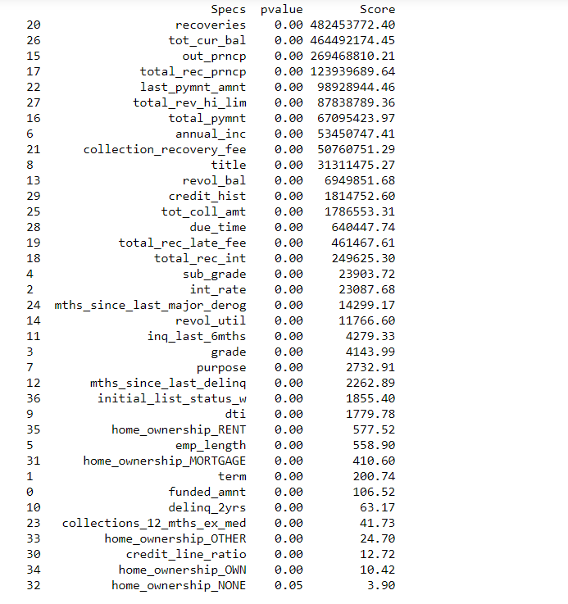
The feature scores are as follows:

Slide 18
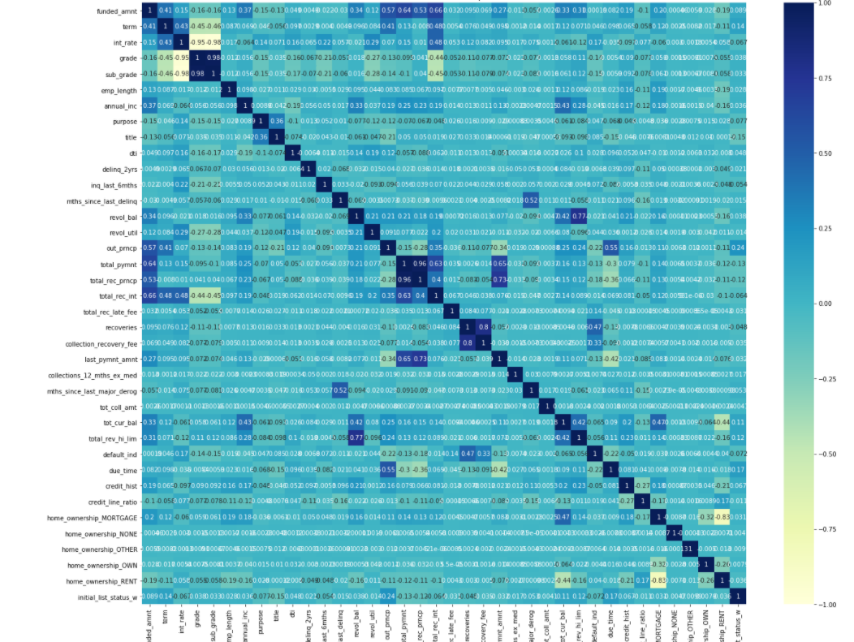
Further, a heat map has been plotted to validate the scores for feature selection.

Slide 19
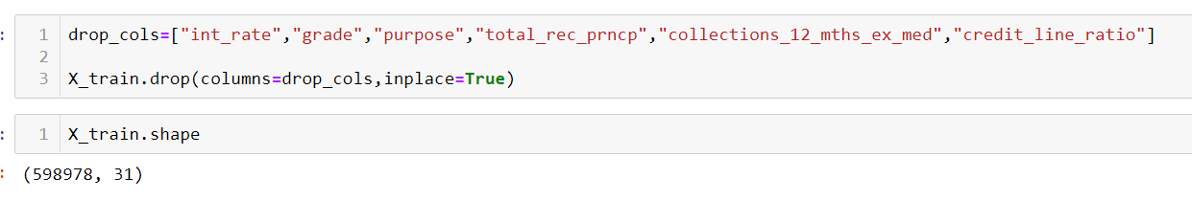
The features that have shown lower scores are now deleted from the data.
After deletion, we are now finally left with 31 variables out of 73 (these variables are dummy variables inclusive).

Slide 20
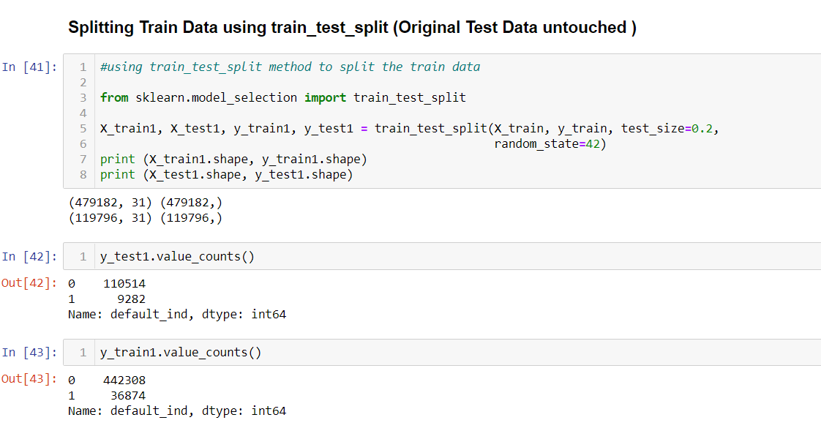
Splitting Train data to Train and Test Data:
The available train data has been split into train and test data using the train_test_split() function
The data has been divided in the ratio of 80-20, where 80% being train data and 20% being test data

Slide 21
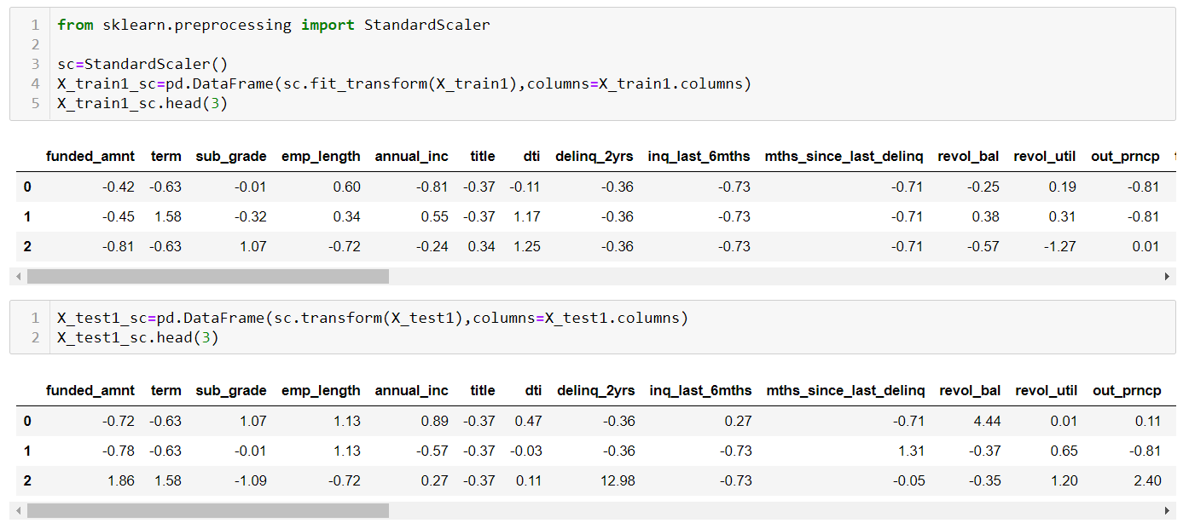
Scaling The Data:
The scaling of data is essential for the algorithms that are gradient-descent based or distance-based.
Logistic regression is a gradient descent based algorithm. Hence it is essential to scale the data before feeding it to the model.
StandardScaler() has been used here to scale the data.

Slide 22
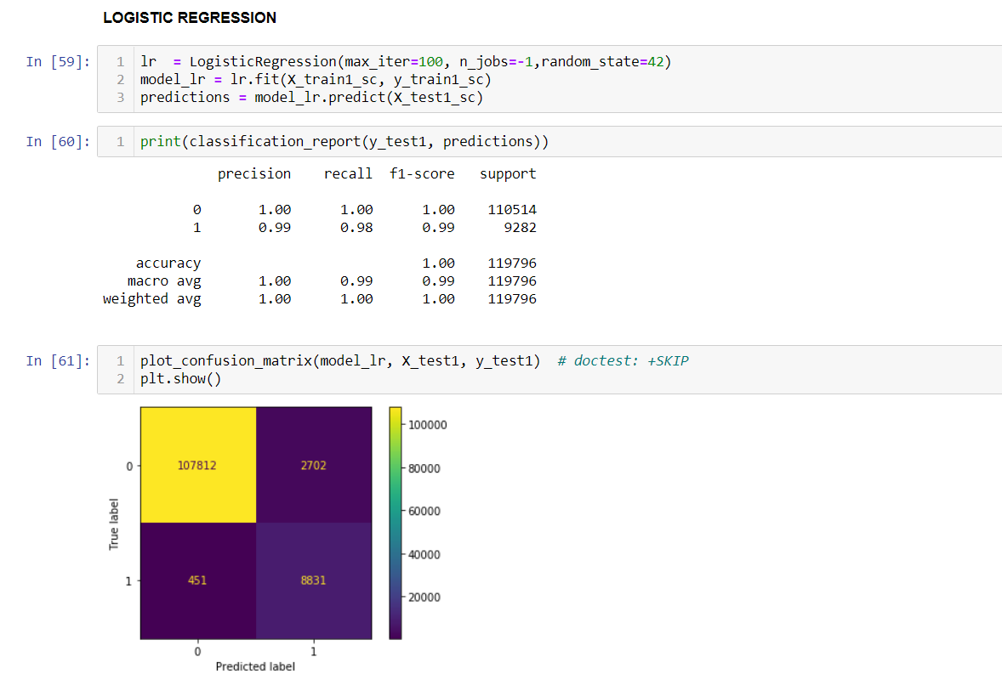
Fitting Models to Data:
LOGISTIC REGRESSION-

Slide 23
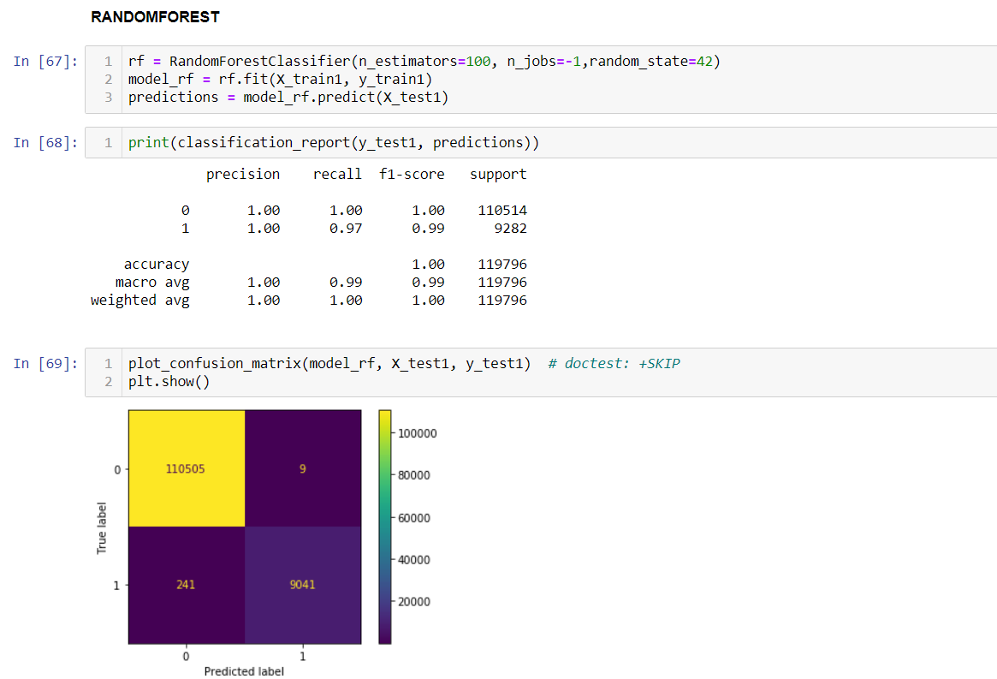
Fitting Models to Data:
RANDOM FOREST-

Slide 24
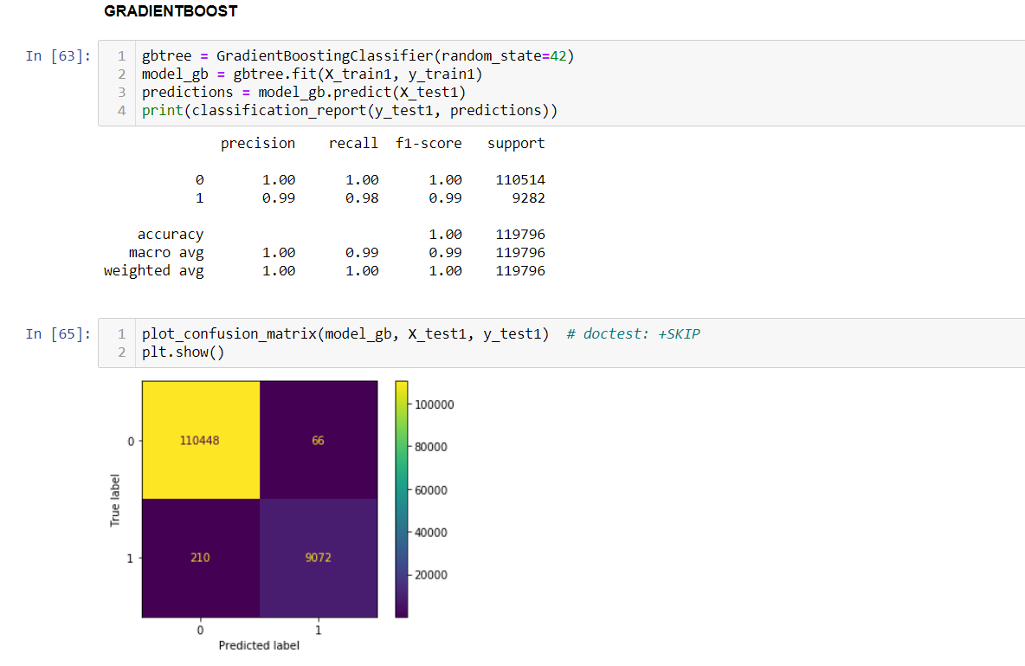
Fitting Models to Data:
GRADIENT BOOST-

Slide 25

Fitting Models to Data:
XGBOOST -

Slide 26
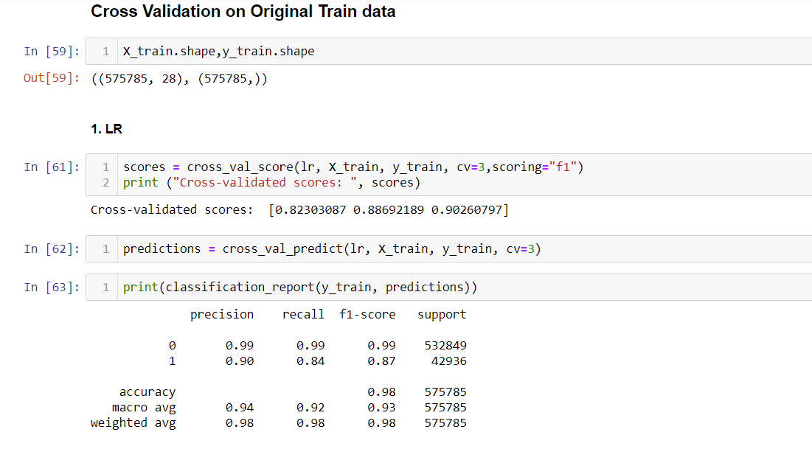
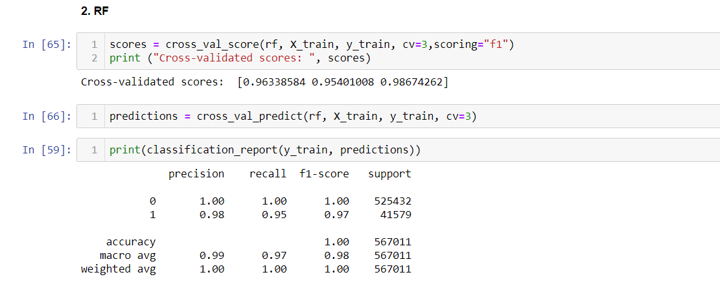
Fitting Models to Data:
CROSS VALIDATION ON THE DATA-
LOGISTIC REGRESSION
RANDOM FOREST CLASSIFICATION

Slide 27
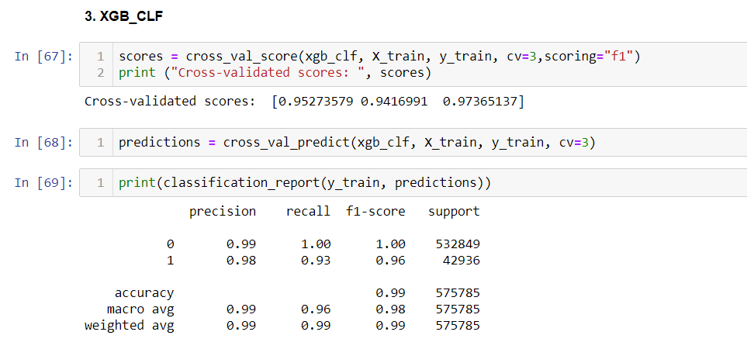
Fitting Models to Data:
CROSS VALIDATION ON THE DATA-
XGBOOST CLASSIFICATION

Slide 28
MODEL TUNING:
As the models are tested for the data, the models are tunned accordingly to develop the final model.
Taking the previous results into consideration, Random Forest Model and the XGBoost Models have generated best results.
The results of both the models post tuning are as follows:

Slide 29
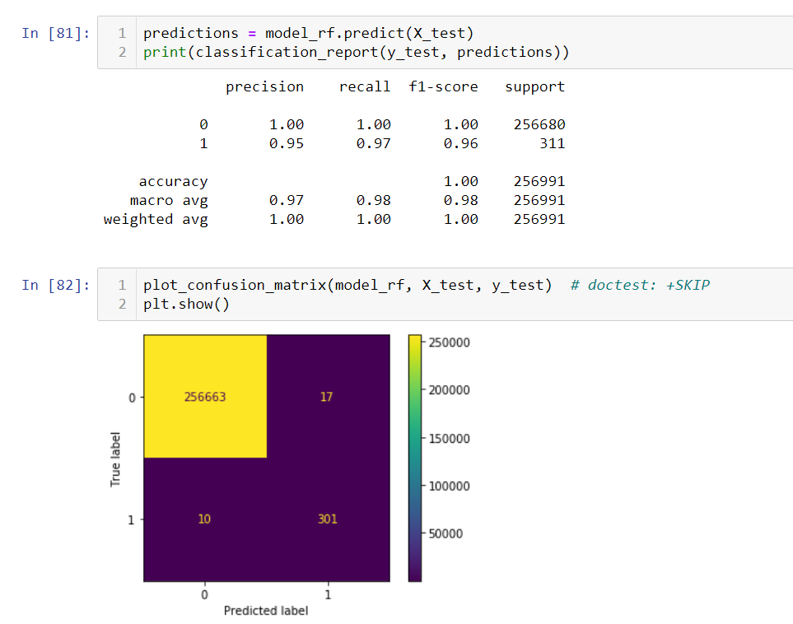
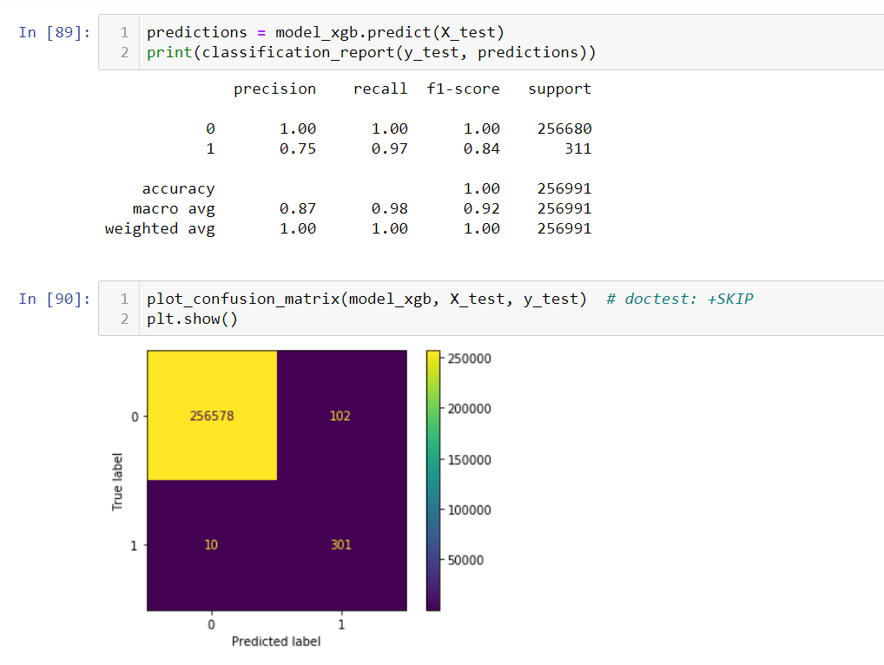
RANDOM FOREST
XGBOOST CLASSIFICATION
The f1-Score for RANDOM FOREST is better than that for XGBOOST.

Slide 30
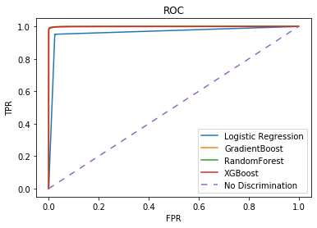
Fitting Models to Data:
ROC CURVE FOR ALL THE MODELS-
The ROC curve gives information about model performance. The farther the line from the diagonal , the better the model performance.

Slide 31
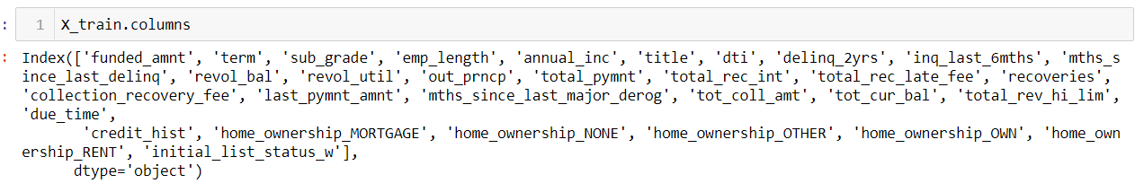
Model Implementation on the Unseen Test Data:
Final list of columns is as follows:
Just as the train data, the test data (June 2015-Dec 2015) has also been split into X_test and y_test.
X_test= Independent variables
Y_test=Dependent variables
SMOTE (oversampling the data) is performed on Train Data ONLY.

Slide 32
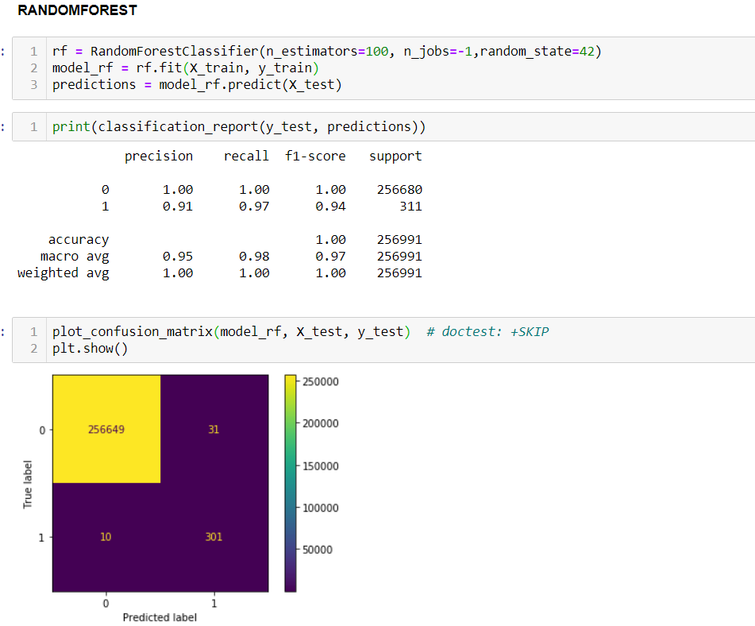
Fitting Model to Test Data:
RANDOM FOREST-

Slide 33
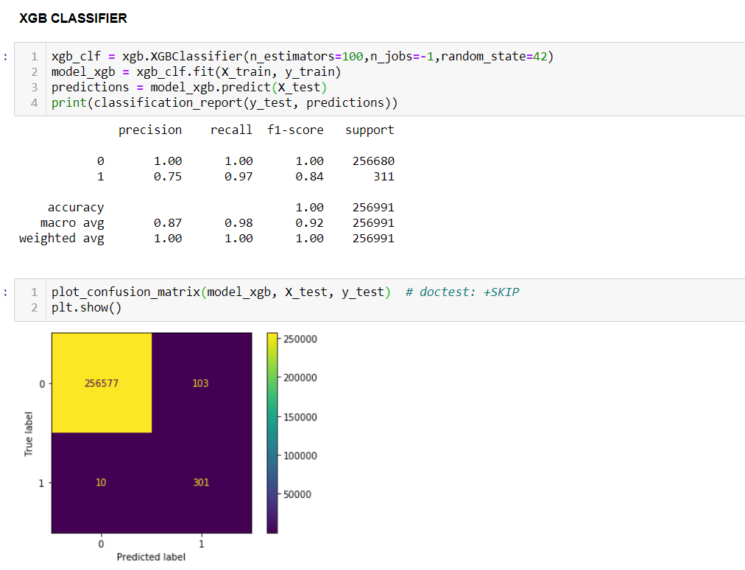
Fitting Model to Data:
XGBOOST -

Slide 34
Final Prediction:
After comparing various models, the Random Forest classifier (with tuning) is the best model so far.
The precision-recall values are best given by the Random Forest Model so far.

Slide 35
Conclusion:
The results of XGBoost and Random Forest were the best among all.
If you want low type 1 error, use either of the two.
If you want low type 2 error, use Random Forest.
Type 2 error shows the actual losses for the company and type 1 error shows the failed profit.
As type 2 error is more dangerous in our case, we should prefer using Random Forest.

Slide 36
THANK YOU

